Slide 1
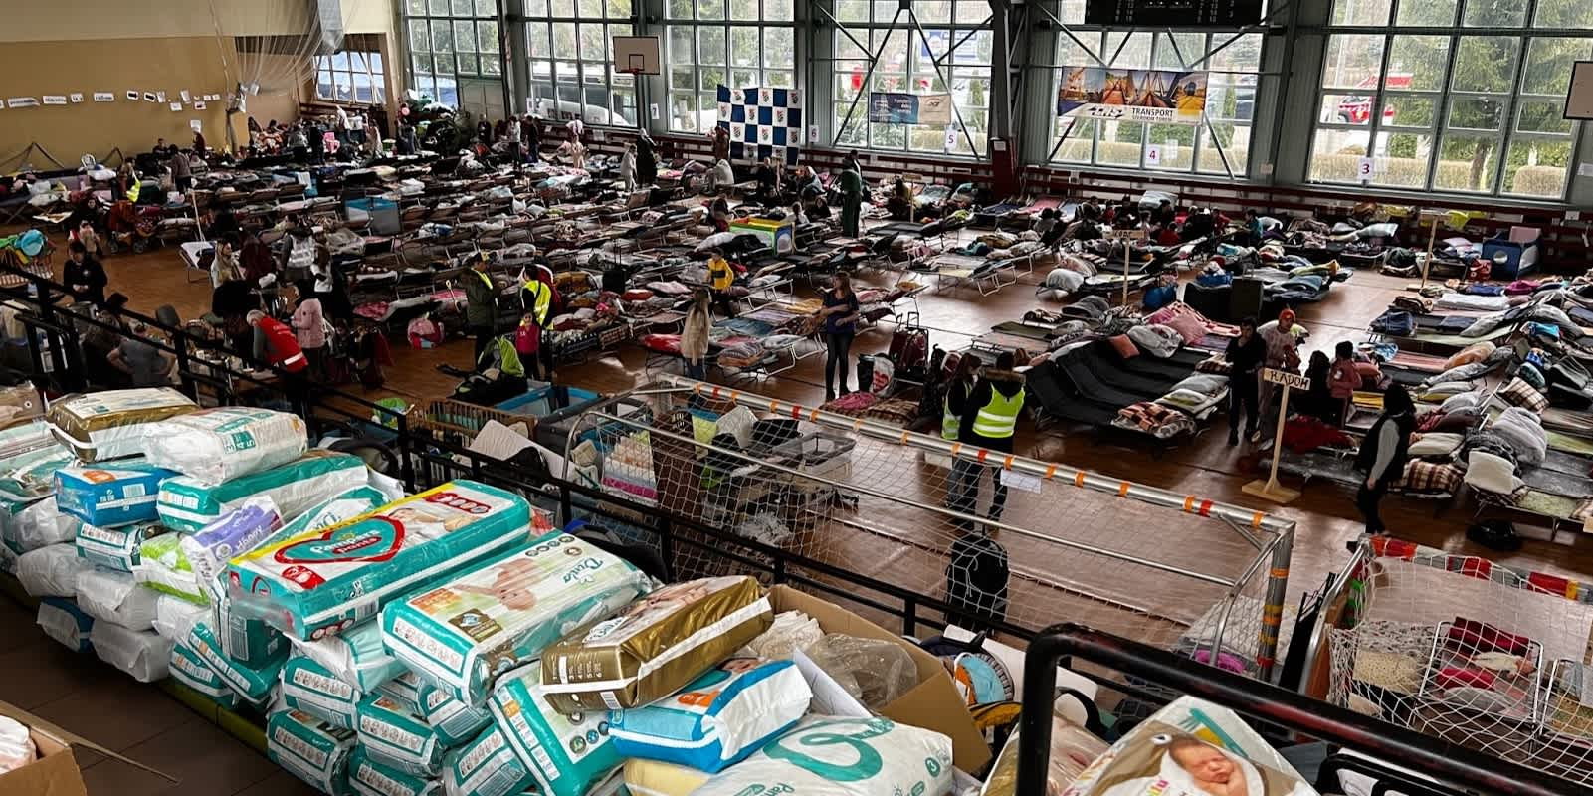
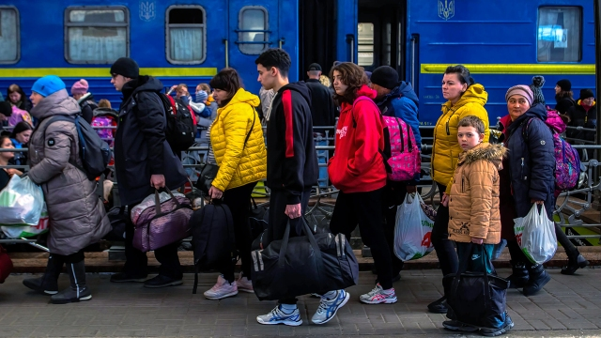
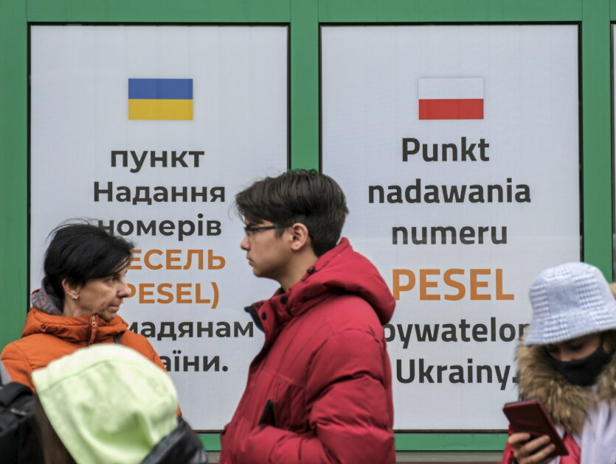
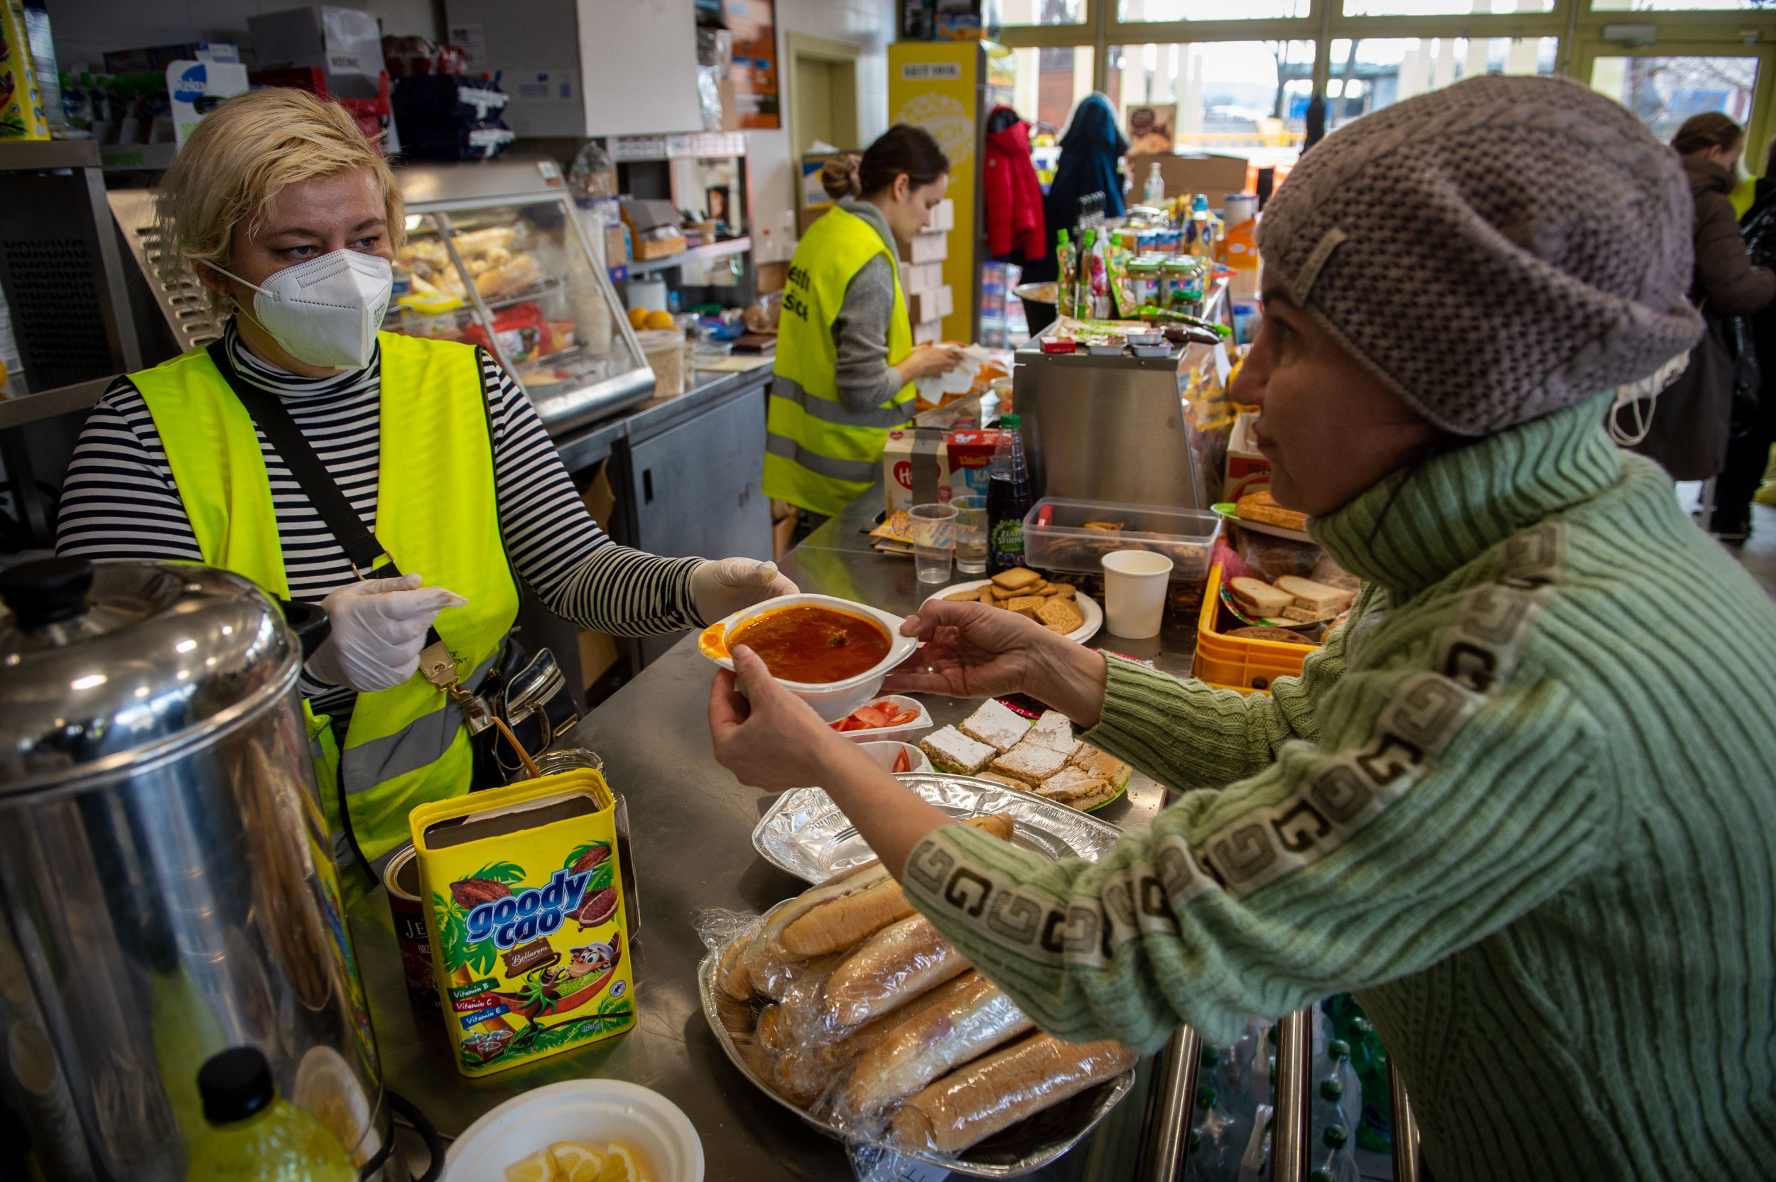
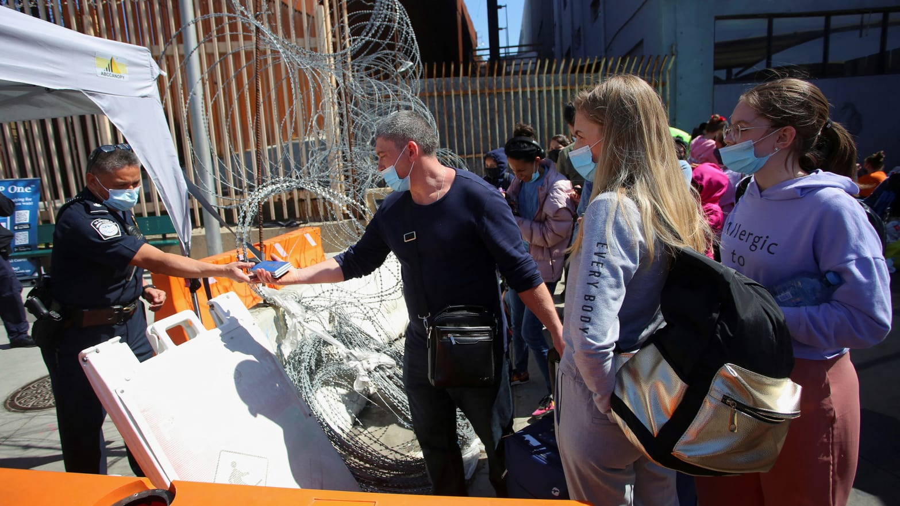
Impact Areas * where to put this slide? *
Identified the most impactful ways to help the refugees
Shelter
Food
Health Services
Transport
Translation
Legal
Other

Slide 2
Crisis Management App
avanade-global-hackathon-spring-2022

Slide 3




The Team
Tomasz Michniewicz
Sr. Cons, Full-Stack Dev
Jaime Castillo
Cons, Full-Stack Dev
Veena Mathews
Cons, Full-Stack Dev
Luke Iremadze
Sr. Analyst, Full-Stack Dev

Slide 4
Inspiration

Slide 5
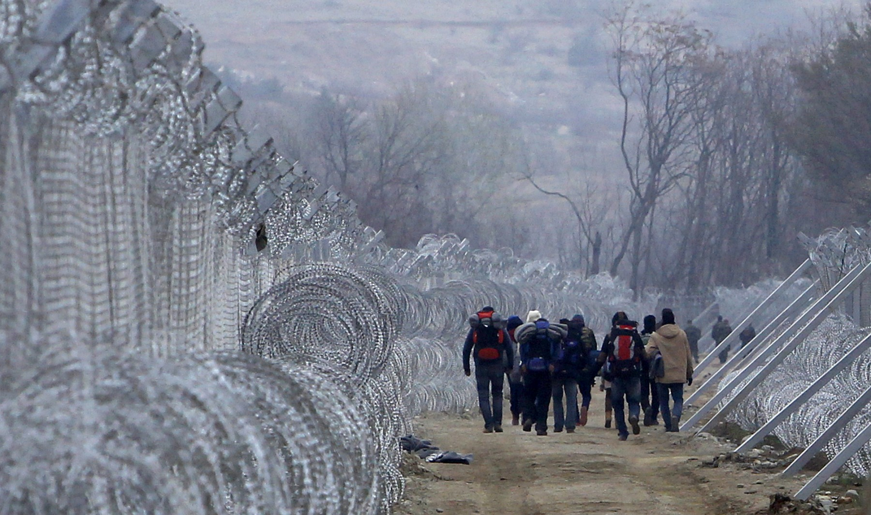
The war in Ukraine
Looking at the current affairs and the war in Ukraine, we wanted to help the people in crisis in someway.
We started by asking these questions:
How can we help (as developers)?
Who needs help ?
What are the most needed help for Refugees in this situation
How can someone volunteer ? (as individuals)
How can institutions look for volunteers ?

Slide 6
Crisis App Solution
We looked at what is already in the market:
Only provides static information
Possibly outdated
People had to go to many different resources / sites to get information on various topics
There were not many AI integrated solutions (more people were needed to update)
Could not contact people directly (video chat / phone call)
Could we use beacons / location information to feed live data (number of people in the location, wait time, if resources are available or needed currently)

Slide 7
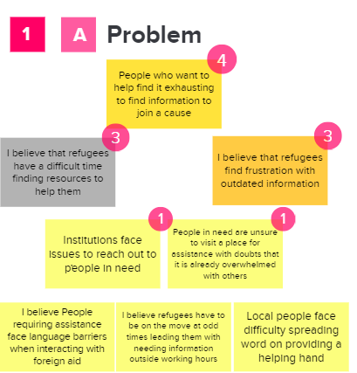
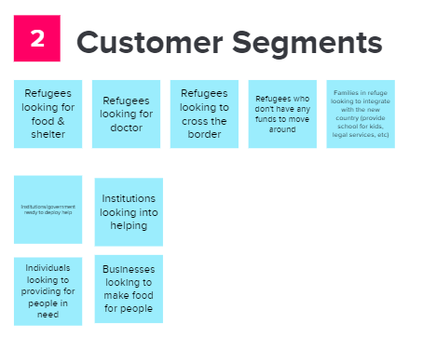
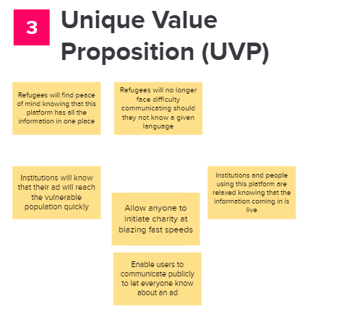
Our Approach

Slide 8
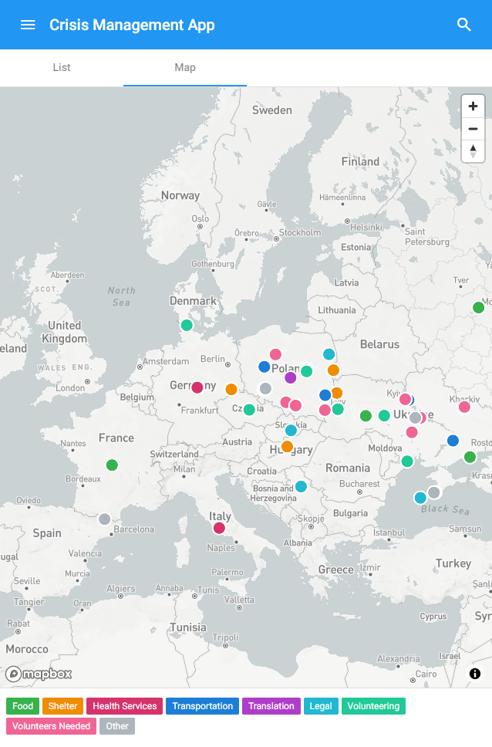
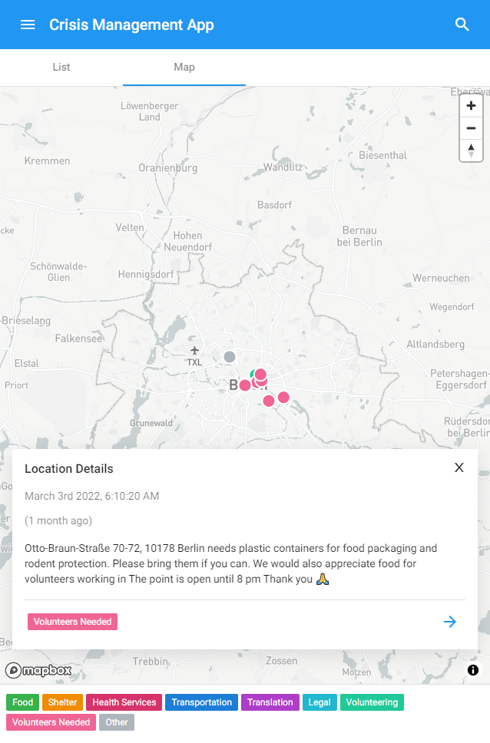
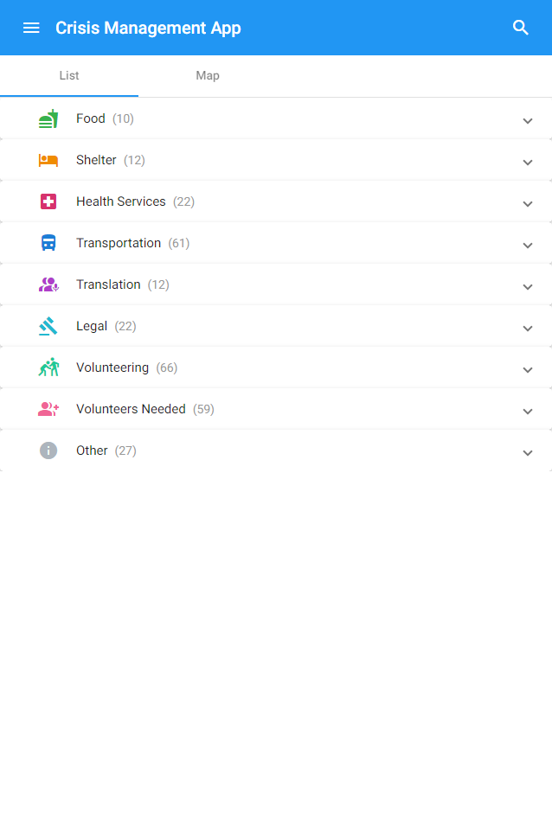
Crisis Management App
Information is easier to find (vs text messages in countless groups and channels) – better insight and situational awareness.

Slide 9
Technology & Architecture

Slide 10
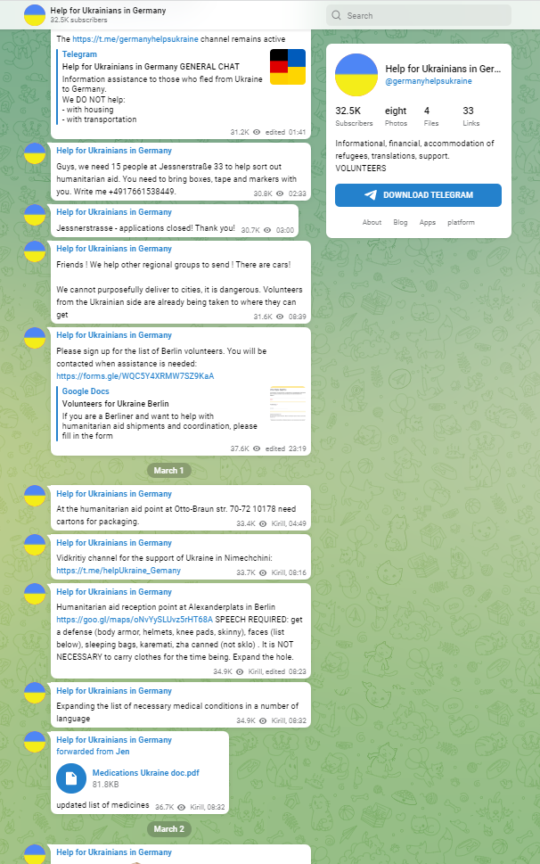
How to turn plain text messages from thousands of different sources into something more insightful?

Slide 11
How does it work?
Collect messages from relevant internet groups or channels (ie. Telegram channels)
For every message, ask a few question to OpenAI about this message in order to try extracting important information (ie. location, message category, etc.)
Clean up AI response (it’s not always perfect, but most of the time good enough!)
Add those messages to a global decentralized database, so everyone can access it
Front end app simply displays the messages

Slide 12
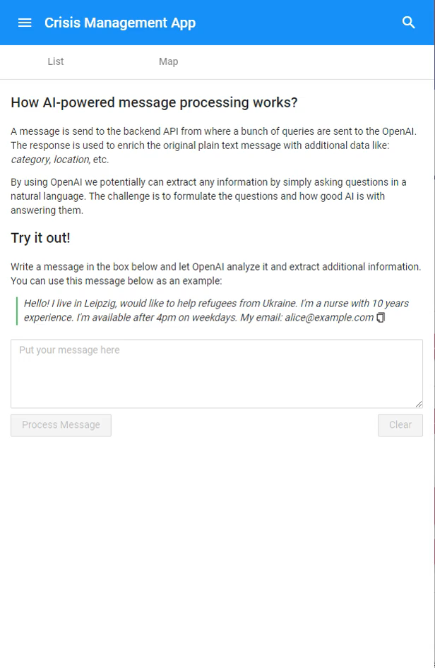
Processing messages with OpenAI
A set of questions (in natural language) are asked about the message, and AI (most of the time) is able to correctly answer them.
It is possible to extract more detailed or specific data by simply asking more precise questions.
In the app we asked to extract the location first and the following question was to return location (lat, lng) using answer to the first question as an input.

Slide 13
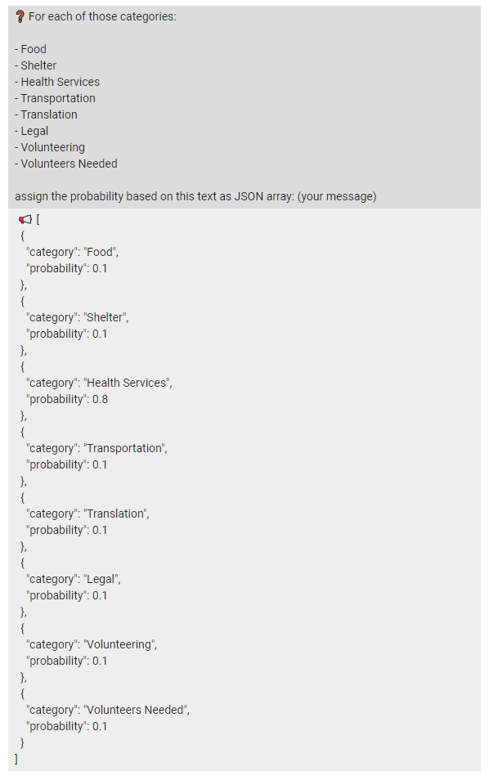
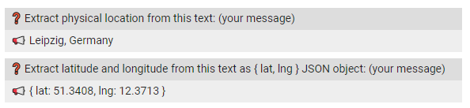
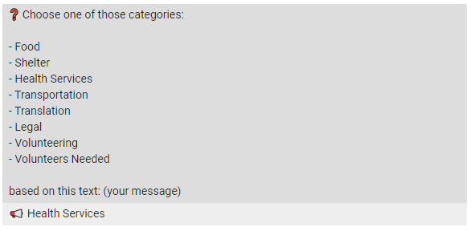
OpenAI – asking questions

Slide 14





Frameworks, libraries, APIs
Angular with Material components (speeds up prototyping, works on mobile devices, look&feel like a native mobile app)
Node.js with Express.js (simply yet powerful server, easy to code – JavaScript)
OpenAI
Telegram API (to get messages from real channels and groups – demo app shows messages entered by people during the Ukranian crisis)

Slide 15
Design

Slide 16
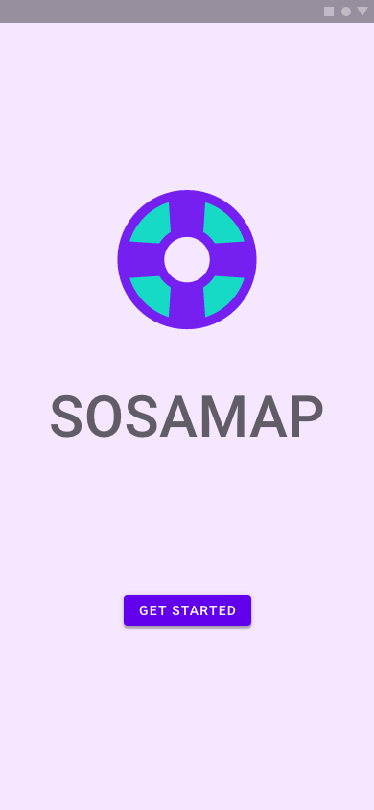
The start
Ideally would have interviewed people
Design Thinking was based on top 3 problems identified
Material design for mobile interface
Adobe XD
Notes:
Ideally, we would have interviewed people and created personas which would have guided our design process.
But due to lack of time the design thinking process was based on the Mural we created where we identified the top 3 problems
We came to the conclusion that this is suppose to be a mobile interface, as such we choose Material Design Language and constructed the wireframes in Adobe XD

Slide 17
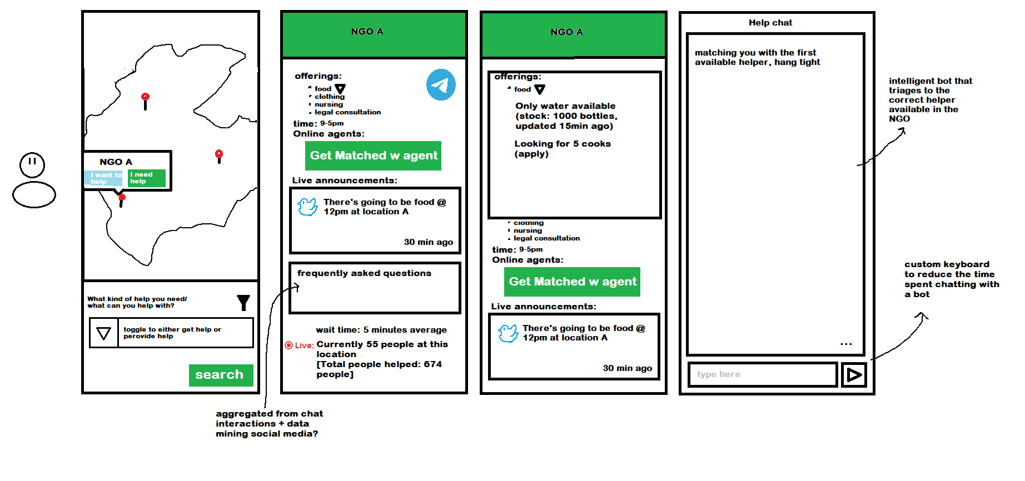
Iteration 0
Notes:
In the design world nothing flies from the sky, so you start with a very rough sketch and then you iterate on it

Slide 18
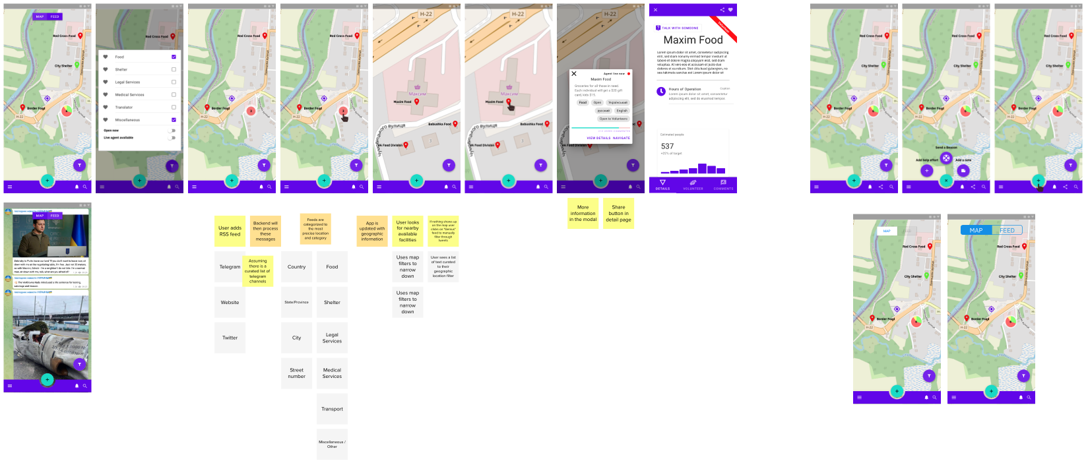
1st iteration
Notes:
And you iterate on it with the feedback given (as seen in the sticky notes)

Slide 19
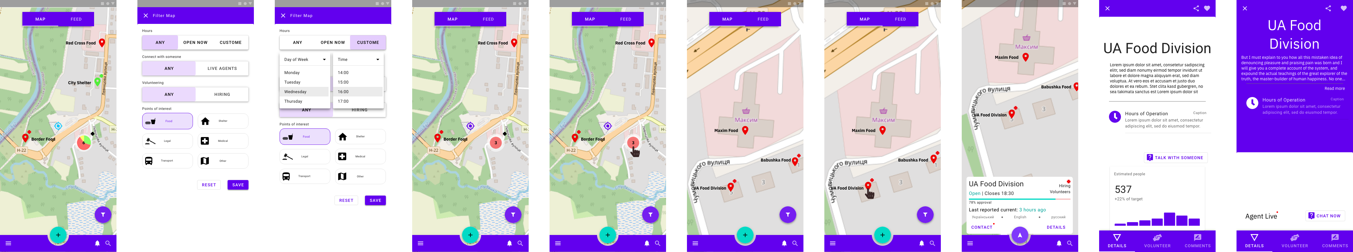
2nd iteration
Notes:
And you iterate on it

Slide 20
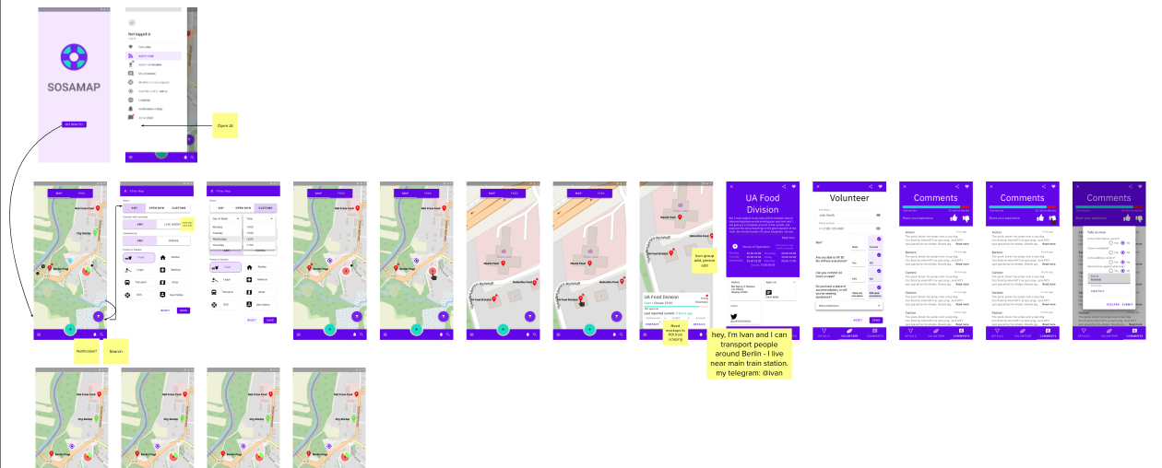
3rd iteration
Notes:
And you iterate on it

Slide 21
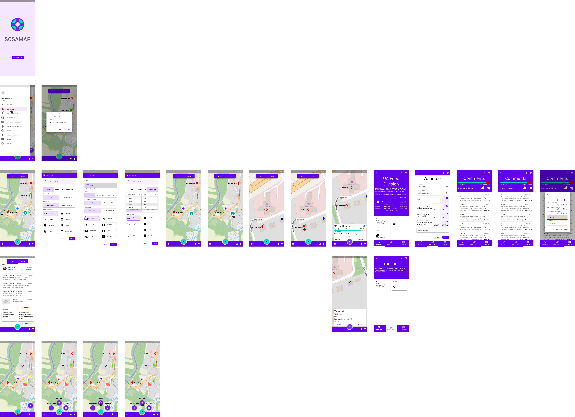
4th iteration
Notes:
And you iterate on it

Slide 22
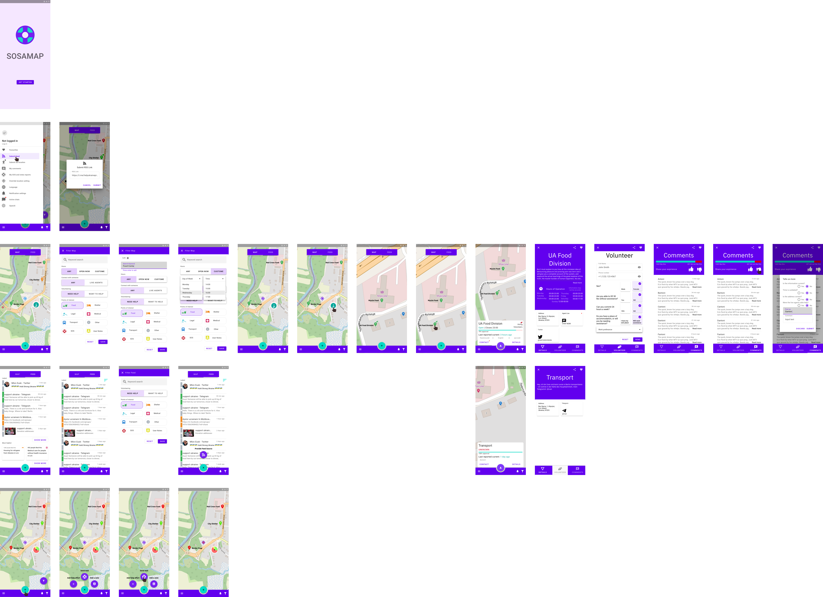
5th iteration
Notes:
Until you arrive at your destination

Slide 23
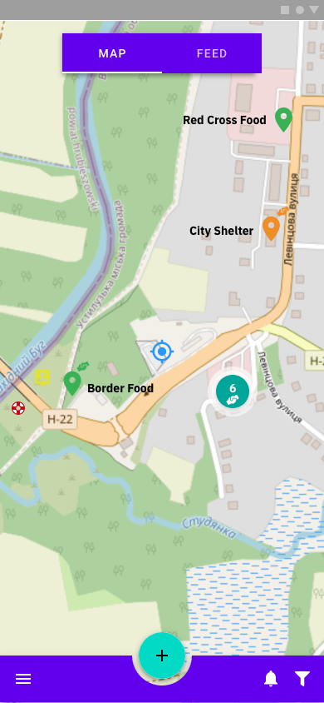
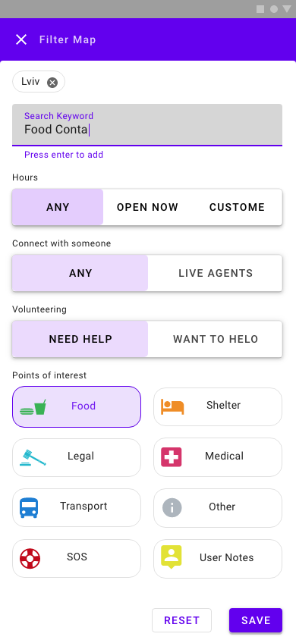
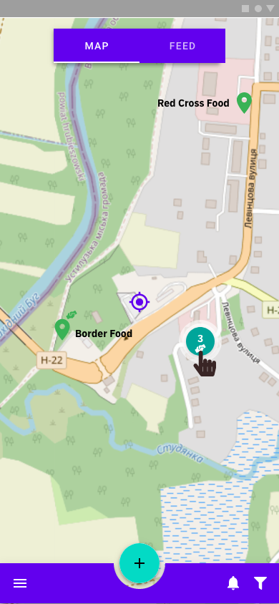
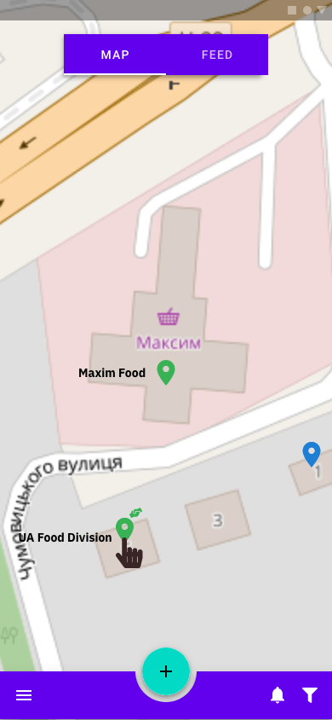
A quick overview

Slide 24
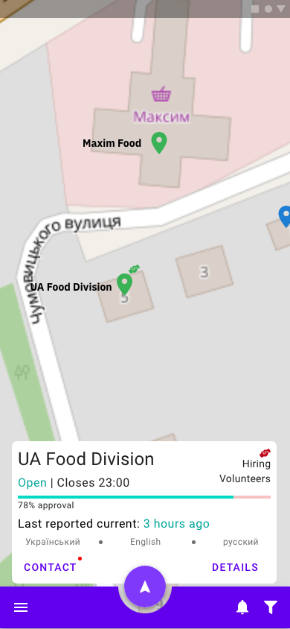
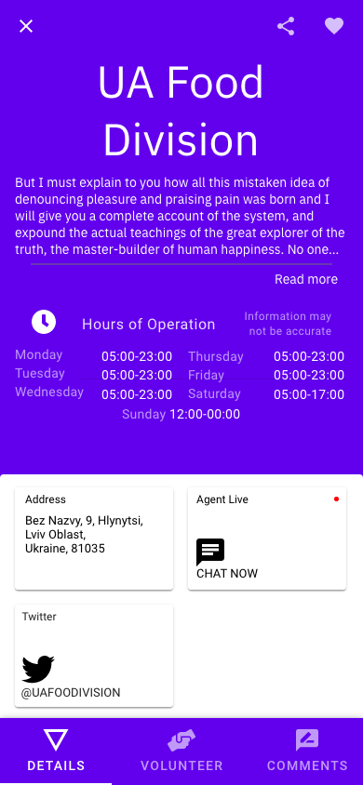
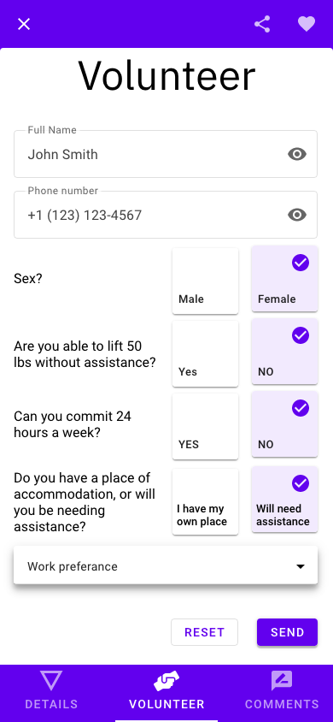
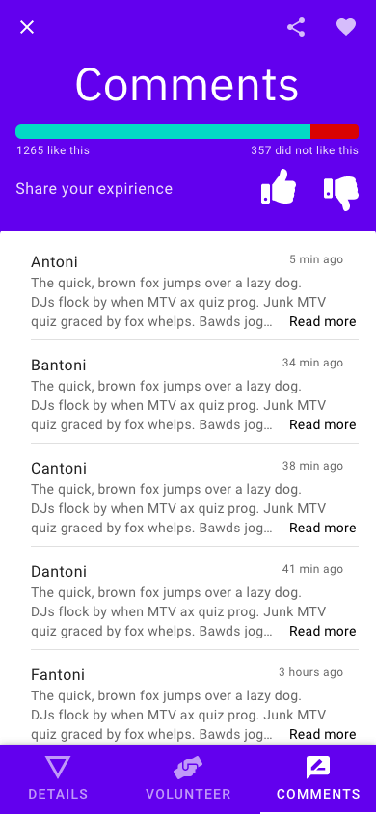
A quick overview

Slide 25
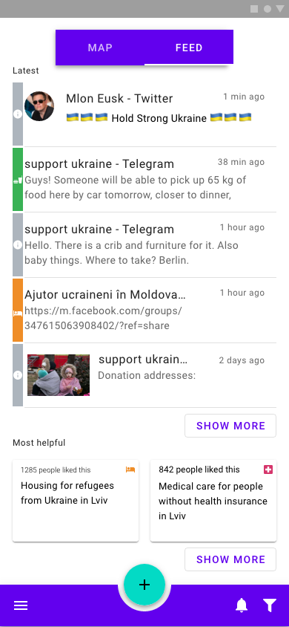
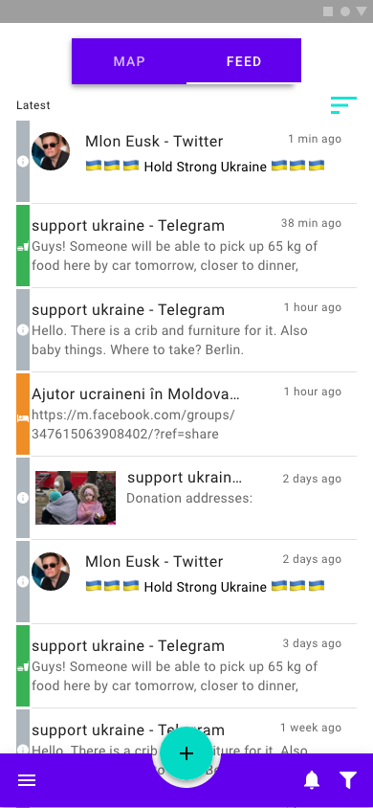
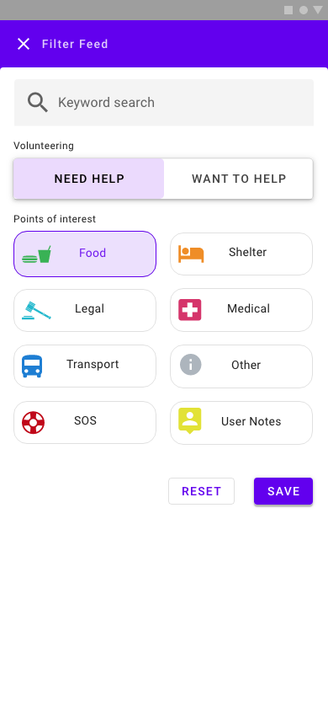
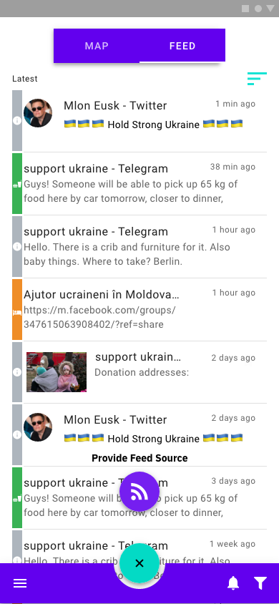
A quick overview

Slide 26
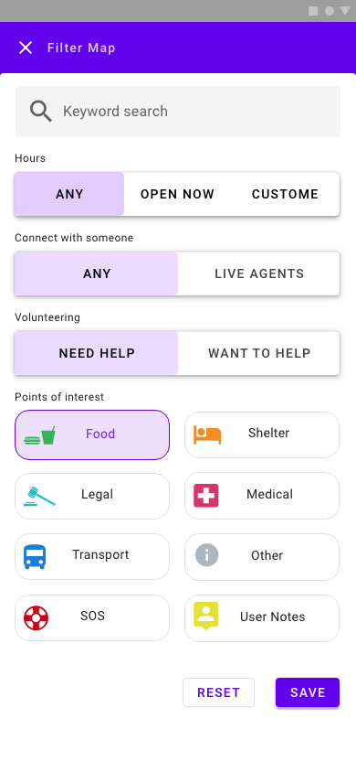
How design thinking helped guide us
Notes:
The most important problem we identified was the lack of being able to find where to volunteer, as such we placed small details as well as the ability to apply for a specific location.

Slide 27
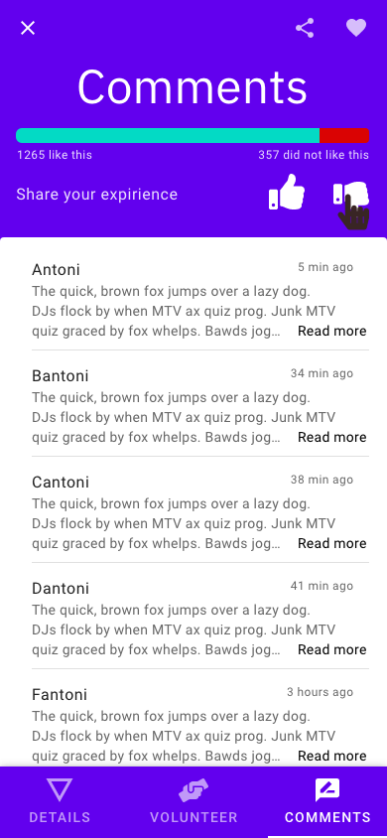
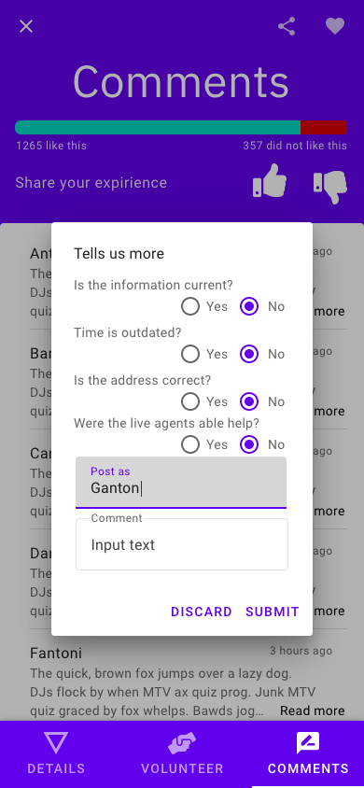
How design thinking helped guide us
Notes:
Then when it came to users frustration for not knowing if a given listing is current or not, or of it its trustworthiness we solved this by facilitating live agents which could be volunteers or officials from listed place, and also brought in user rating and comment section.

Slide 28
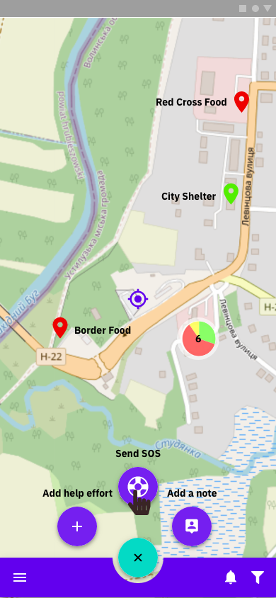
Future features

Slide 29
Business

Slide 30

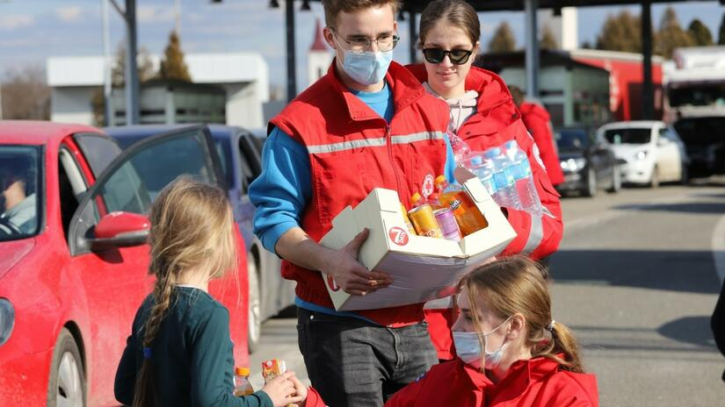
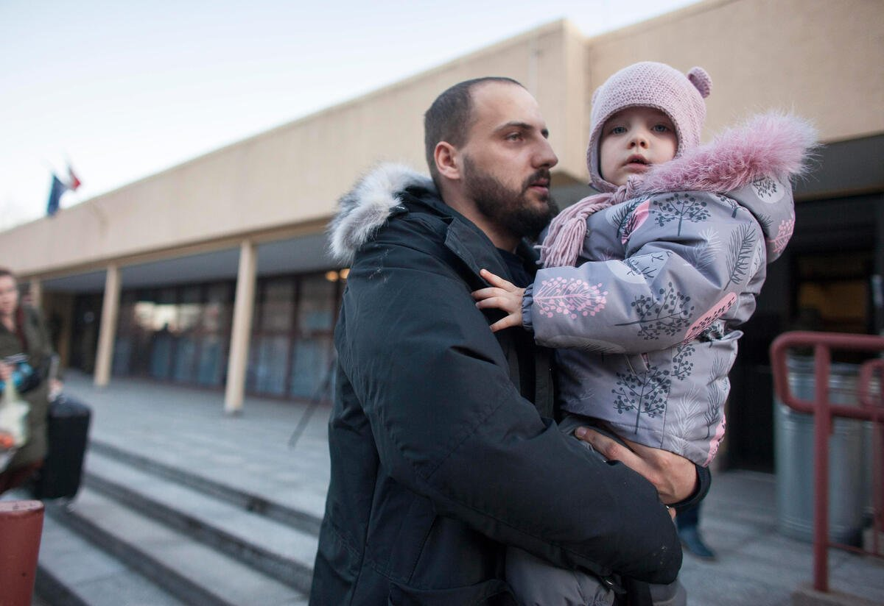

What makes our app unique ?
There are no apps currently where organizations can post a requirement for a need (volunteers, supply, professional services like health services or translation )
There are no applications that can post an add for individuals that are able to help
These help can be done virtually over a video call so it is not location specific
Refugees can also post and look up for services that they are in need of
Live data that shows how many people are at a facility, if they can offer more help, if there are enough supplies or not
I can help
VS
I want help

Slide 31
Business Value
With our application there are many ways to help everyone involved in a crisis
It is a one Stop Shop for any help they are looking for
Both Volunteers & Refugees can find recourses here
This app does not need a human to get or update feeds integrated to the system, with the help of AI and data scraping they are updated automatically.
Data is not stale
Can view map and identify where any help / service is offered

Slide 32
Future of our app
We intend to add more features to this app in the future
In app video call service
Connect any refugee or Volunteer anywhere in the world using this app, refugee and volunteer who can provide a professional service are matched within the app
Live feed updated on locations by crowdsourcing, location data on the phone or by the installation of beacons
Comment / Like section for getting feedback or legitimacy of a location
Rating of service provided within in the application
Can be used for any kind of crisis or situation in the future (Earthquake, general volunteering)

Slide 33
Monetization & Sustainability
As there is yet an app that hat connects organizations and volunteers to people in need there is a very good chance to monetize this application
As this is a crisis application, it will need to be sponsored or crowd funded
This application can also have a feature to accept donations like Wikipedia
If there are services provided for a cost within the application, then there can be a % that is shared
We will need to advertise the application within the organizations that could potentially use our services (UNISEF, Red Cross, World Health Organization )

Slide 34
Links
Demo app:
https://crisisapp.queueoverflow.com/
Source code:
https://github.com/veenamathews/crisis-management-app

Slide 35
